Slide 1
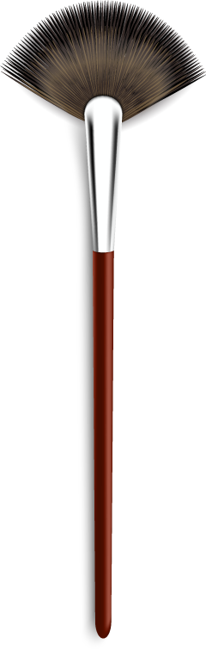
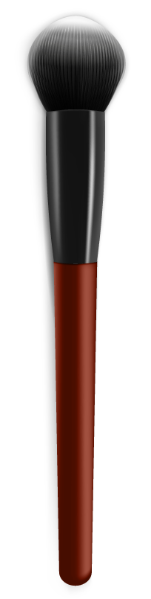
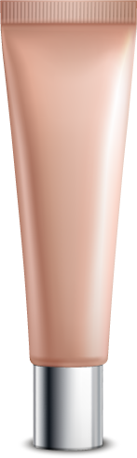

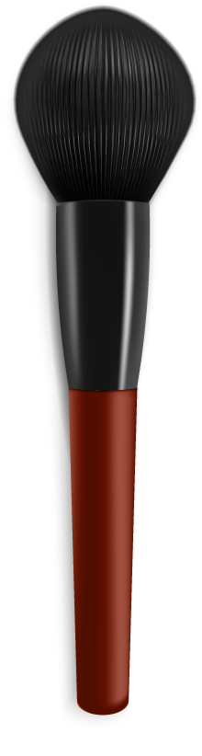
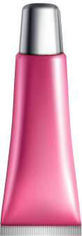
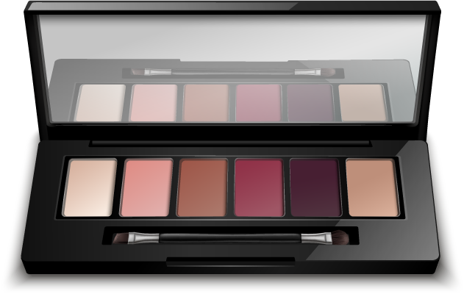
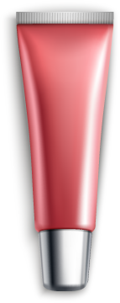
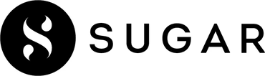
INSTAGRAM PERFORMANCE ANALYTICS USING TABLEAU

Slide 2
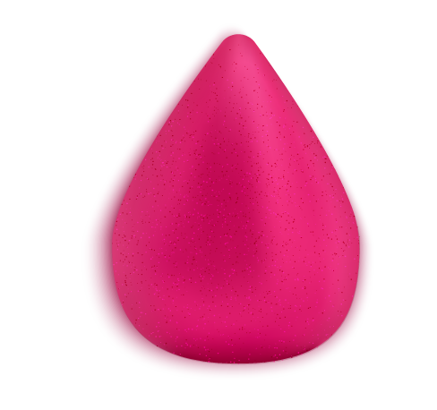
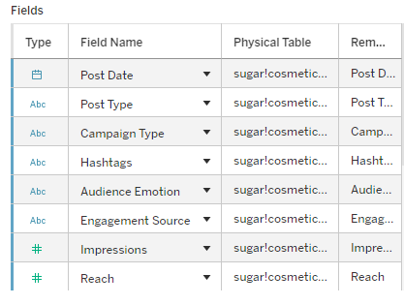
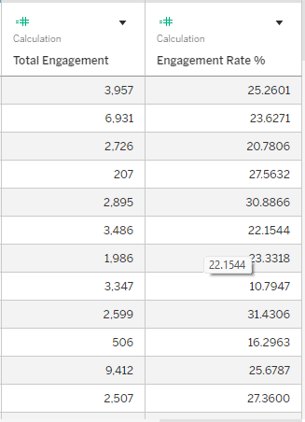
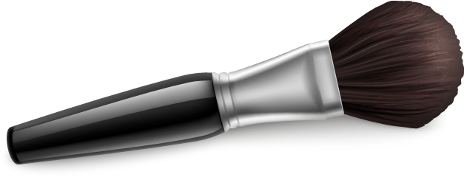
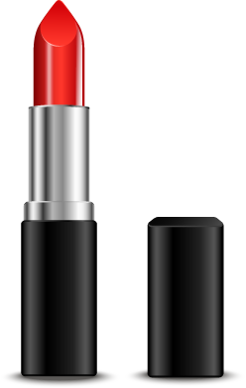
Creating new measures
Datatypes check
01
02
# Null values are checked in Excel

Slide 3
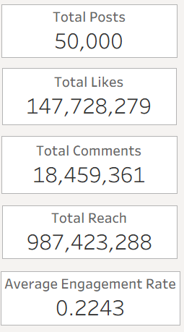
Business Summary:
1️⃣ Total Posts: Sum of Posts
2️⃣ Total Reach: Sum of Reach
3️⃣ Total Likes: Sum of Likes
4️⃣ Total Comments: Sum of comments
5️⃣ Average Engagement Rate: Average of Engagement rate
Engagement Rate: ([Likes] + [Comments] + [Shares] + [Saves] + [Profile Visits] + [Follows]) / [Reach]

Slide 4
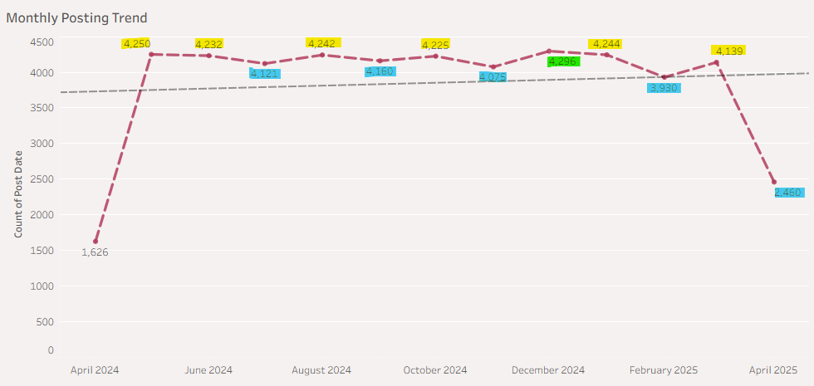
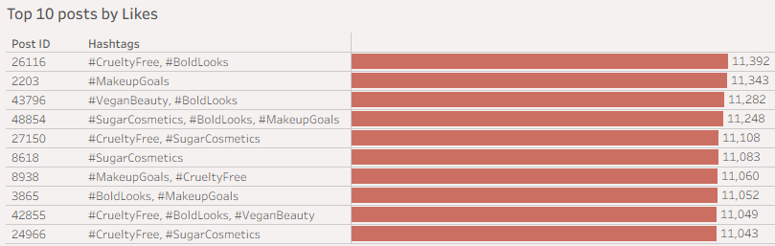
Monthly Posting volume
✔ Relatively stable between ~4,100–4,300
✔ Showing small cyclical (up–down) variation
✔ The brand maintains a consistent posting strategy.
✔April 24,25 - Partial data
✔Top 10 post identified by Hashtag combinations & Post ID (Created for unique identification of post).
✔Can see that #CrueltyFree, #BoldLooks hashtag combination has received the highest no of likes.
✔ Usage of #Boldlooks, #Makeup Goals, #CrueltyFree & Brand name hashtags received high likes

Slide 5
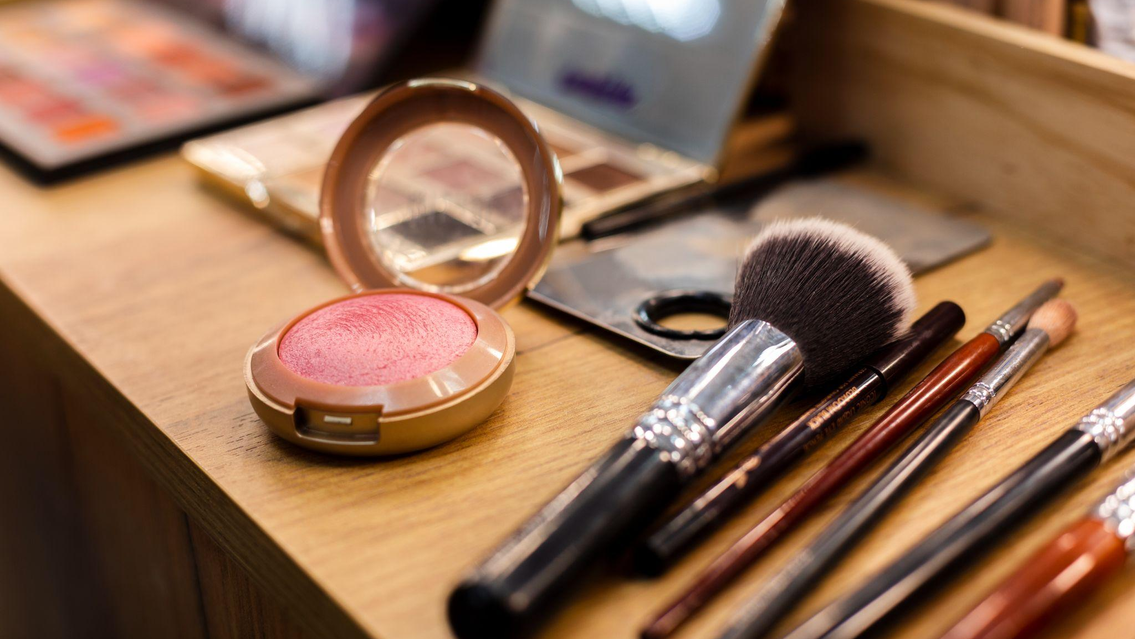
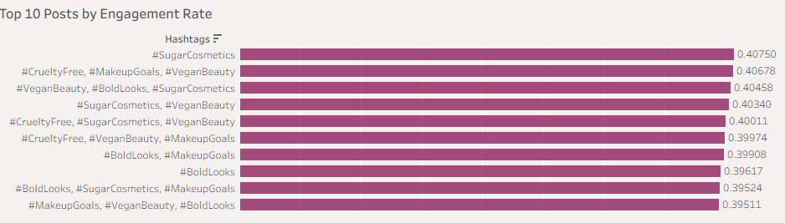
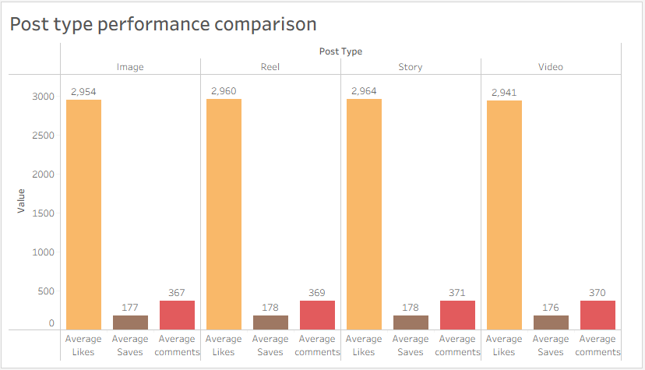
✔ Hashtag combinations with Keyword #VeganBeauty has received the highest no of engagement.
✔Brand name Hashtag #Sugar Cosmetics received the Top Engagement Rate
✔By applying Date to the Rows can also see which dates/months is performing well in terms of the engagement rate
Stories receive Highest Average Likes, Average Saves and Average comments than other post types.
Videos receive the least Average Likes and saves

Slide 6
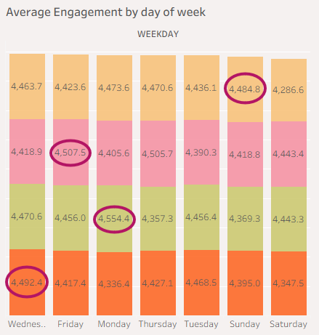
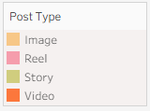

Day of Week Analysis
The overall Average Engagement is high during Wednesdays and low during on Saturdays
Post type wise better Average engagement days:
Images: Sundays
Reels: Fridays
Stories: Mondays
Videos: Wednesdays

Slide 7
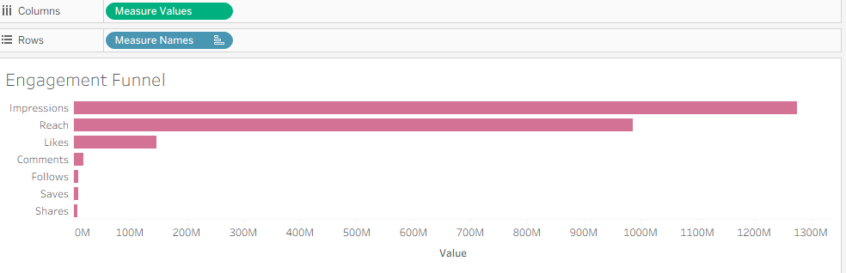
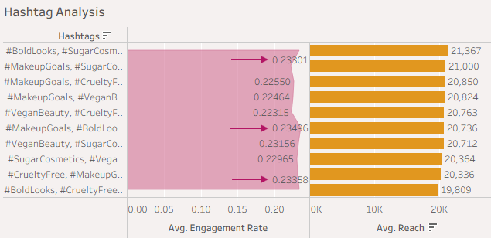
Engagement Funnel
Out of 1276M impressions, the reach is only 987M, Likes is 147M. Other engagements like Comments, Follows, saves, shares are less than 18M
Hashtag Analysis
Top 10 Hashtags as per Avg Reach is listed. In addition to this Avg Engagement rate is combined to analyze which Top 10 high Reach Hashtags has more Avg engagement rate
High reach does not always lead to high engagement
Notes:
Insights from Hashtag Analysis
1️⃣ Hashtag combinations with #MakeupGoals and #BoldLooks generate higher engagement compared to other hashtag groups.
2️⃣ #SugarCosmetics-based combinations achieve higher reach, indicating strong brand visibility.
3️⃣ #VeganBeauty and #CrueltyFree hashtags show stable performance, reflecting interest in ethical beauty content.
4️⃣ Some hashtag combinations have high reach but lower engagement, showing that visibility does not always lead to interaction.
5️⃣ Combining brand, trend, and ethical hashtags helps maximize both reach and engagement.

Slide 8
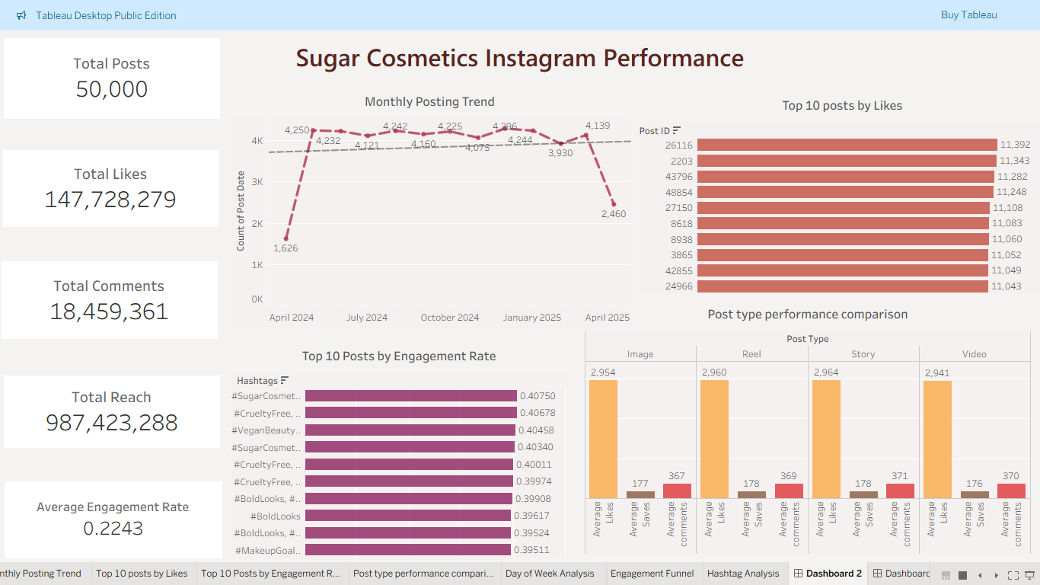
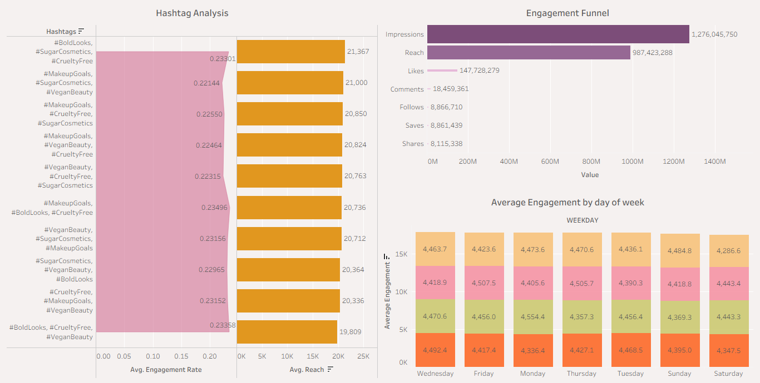
DASHBOARDS

Slide 9
Insights to enhance the social media strategy
✅ Insight 1: Hashtag combinations related to brand name, beauty, Vegan and cruelty-free themes generate the highest engagement, indicating strong audience interest in niche and value-driven content. From Engagement Tunnel and Hashtag Analysis its clear that High reach does not always lead to high engagement, suggesting that selecting relevant hashtags is more effective than using popular ones
✅ Insight 2: The days of Week, Post type, Hashtags have direct impact on the engagement rate.

Slide 10
Strategic Recommendation
✅ Posting Strategy
Focus on stories and Reels, shared consistently during high-engagement days (Wednesdays & Fridays).
✅ Engagement & Growth
Use high-performing hashtags and interactive content to increase audience participation and followers.
✅ Gaps & Fix
High reach but low engagement indicates the need for more relevant and engaging content.
✅ Content / Campaign Ideas
Run trend-based beauty campaigns and challenges aligned with brand themes.

